Slide 1
Android Facial Recognition
DS-15
February 1, 2019
Yujia Fan, Peter Stilian, Yi Hu, Kenneth Huang

Slide 2
Table of Contents
Objective and Approaches
App Framework
Notification System
Reflections & Progress

Slide 3
Objective and Approaches
To create an Android App that will detect faces in camera feed.
Compares detected faces with 5 unique faces. The app will alert the operator if face matches.
Implement a notification so that a face that when a face in the app’s Added Persons library is identified, a notification will be sent to the user
Existing facial recognition app
Testing effective models for facial recognition
Implementation of a notification system into proprietary source code

Slide 4
App Framework
Classifications
Eigenfaces with NN: face size = 25x25; PCA = 0.98
Image Reshaping with SVM: face size = 25x25
TensorFlow with SVM or KNN: face size = 160x160; K = 20 (KNN)
Caffe with SVM or KNN

Slide 5
Test results
With the native Android native face detection api, faces can be identified within a range of 10-12 feet.
Training & Testing Speeds: (fastest) Tensorflow with SVM >> Tensorflow with KNN >> Eigenfaces with NN >> Image Reshaping with SVM (slowest)
Distance: (with an Android front-facing camera - Galaxy Note 4)
Using TF with SVM or KNN and Eigenfaces with NN, faces can be identified within 4 to 15 Inches.
Using Image Reshaping with SVM, faces can be identified within 4 to 20 inches (Slow detection).
Accuracy: Eigenfaces with NN is not accurate on my case.

Slide 6
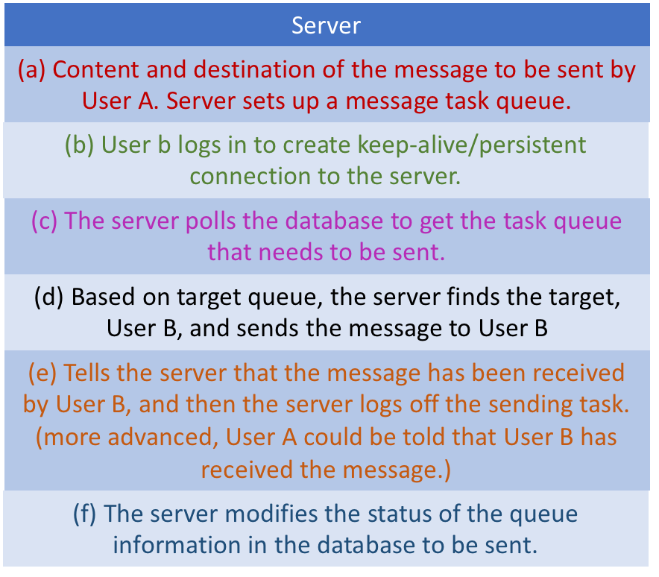
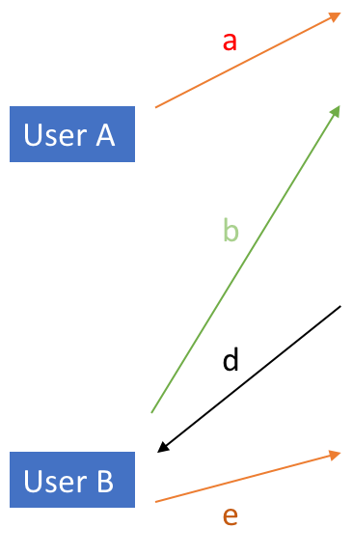
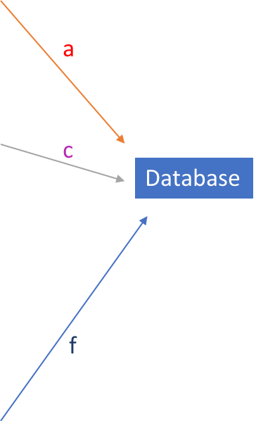
Notification System

Slide 7
Progress and Follow up
Found an existing facial recognition app that can implement 4 major models.
Concentrated on a notification function for the facial recognition app to alert the user if a saved face is recognized.
Found sample code of notification function and incorporated it into the base detection program.
Testing different pre-trained models to determine which one is most effective for accurate facial recognition (prelim test: Tensorflow wins!)
Future work: fix Caffe with SVM and test all four models on larger datasets for accuracy rates

Slide 8
Thank you!

